Slide 1
Week 12 – Advanced

Slide 2
Topics
Flask App
Facial Recognition
ChatGPT Interface
Text Encryption
Voice Recognition and APIs

Slide 3
Flask Apps

Slide 4
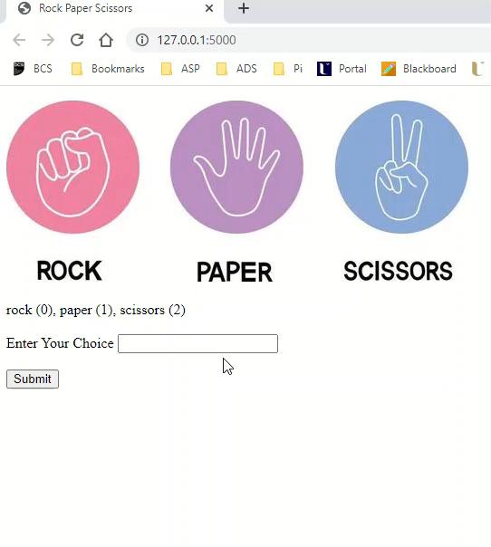
Flask app – a game
Assuming we have a Python program that allows the user to play Rock, Paper, Scissors – let’s see how we can adapt to run in the browser as a web application

Slide 5
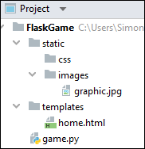
What is a Flask app?
Flask is a small and lightweight Python web framework that provides useful tools and features that make creating web applications in Python easier.
If you want to get a web application up and running with just one Python file, then Flask is the one for you. It can be deployed locally or remotely.
All the heavy lifting is done for you. In this example,
we only have to script two files – home.html and game.py

Slide 6
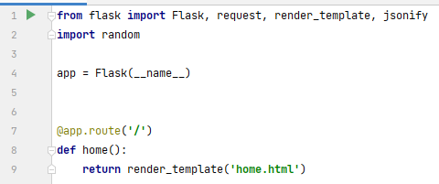
Game.py
First all, import the Flask object from the flask package. You then use it to create your Flask application instance with the name app. You pass the special variable __name__ that holds the name of the current Python module. It’s used to tell the instance where it’s located—you need this because Flask sets up some paths behind the scenes.
Once you create the app instance, you use it to handle incoming web requests and send responses to the user. @app.route is a decorator that turns a regular Python function into a Flask view function, which converts the function’s return value into an HTTP response to be displayed by an HTTP client, such as a web browser. You pass the value '/' to @app.route() to signify that this function will respond to web requests for the URL /, which is the main URL.

Slide 7
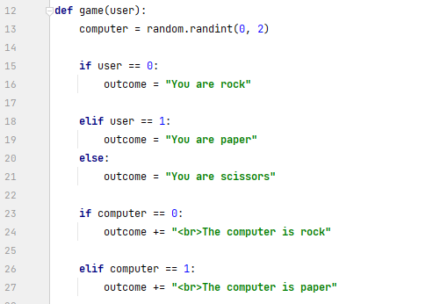
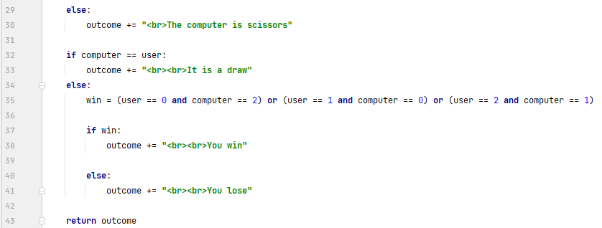
Game.py
Here we build outcome as a string – notice that we are adding HTML tag to the text. This will be rendered by the web page.

Slide 8
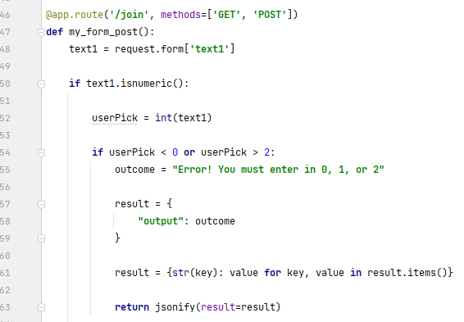
Game.py
Based on the web page request – we have a function that will take in a value from the web page and process it as the user’s choice.
Whatever the user gets told, this will get turned into a data collection and then turned into a JSON string which can be processed by the web page

Slide 9
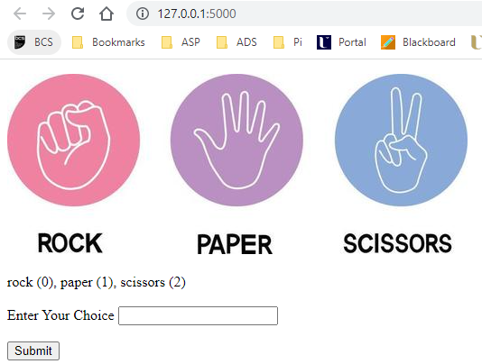
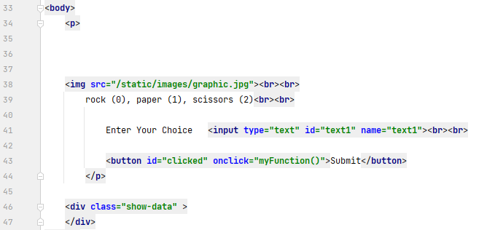
Home.html (html)
When clicked, the button calls a JavaScript function which will populate a div class with the outcome of the user’s choice

Slide 10
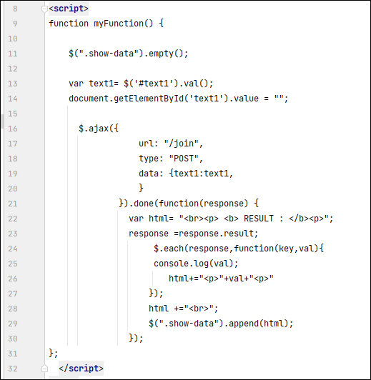
Home.html (JavaScript)
This JavaScript function will use AJAX to send the user’s choice to the Python and process the returned JSON data into HTML in the div class

Slide 11
Facial Recognition

Slide 12
What is facial recognition?
Facial recognition is a technique that uses computer vision and machine learning to identify and verify human faces in digital images or videos.
In a Python context, facial recognition can be implemented using various libraries and frameworks, such as OpenCV, face_recognition, dlib, and TensorFlow.
Facial recognition can be used for various applications, such as security, biometrics, entertainment, and social media.

Slide 13
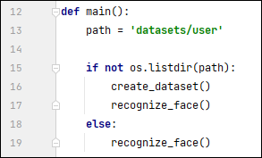
Facial recognition – an example
We need to do two things
Create a dataset
Test your face against the dataset

Slide 14
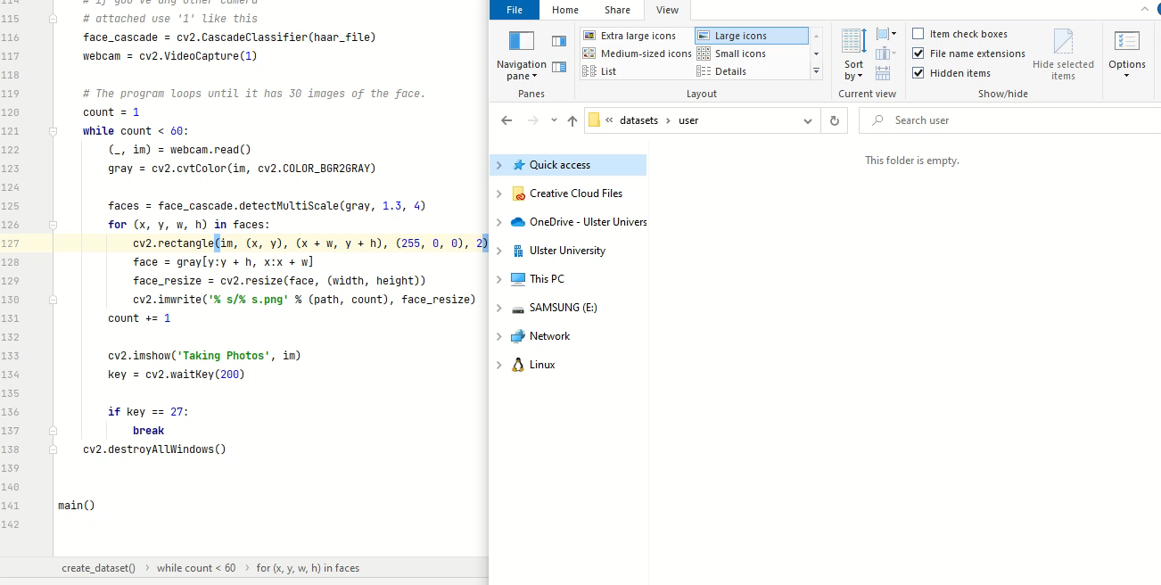
Creating a dataset

Slide 15
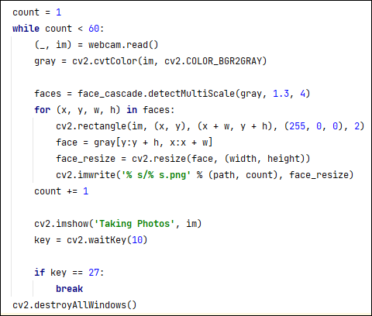
Creating a dataset
A webcam is opened, and there is an attempt to take 60 pics of the user and store them in a folder.
This is our dataset.

Slide 16

Testing against the dataset (video)

Slide 17
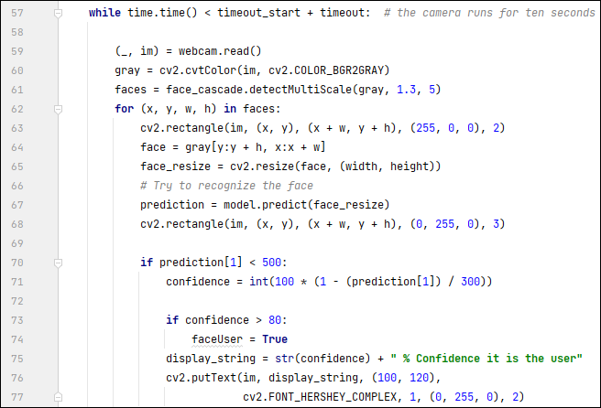
Testing against the dataset
A model is trained from the images and is compared agaisnt the face on the camera stream – an arbitrary (magic) score was given in terms of confidence

Slide 18
ChatGPT interface

Slide 19
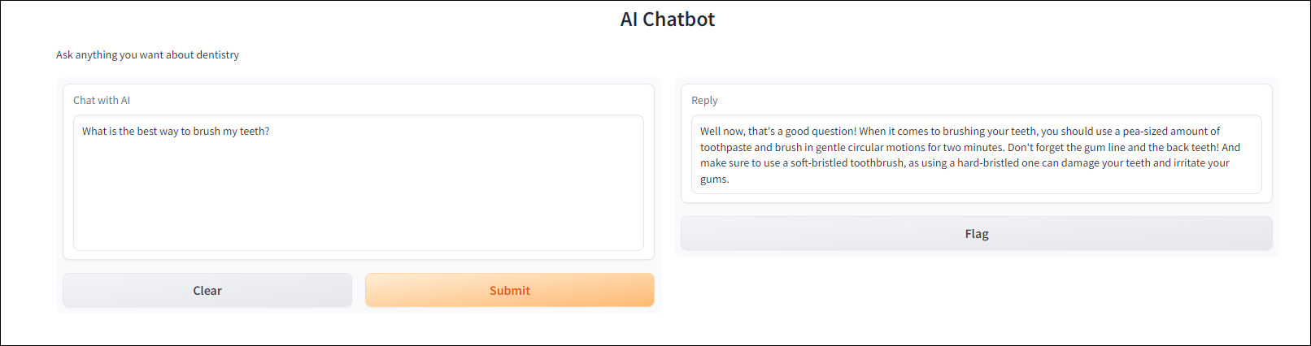
ChatGPT
Using Python, create a front-end (console, GUI, web app) that will allow a user to use ChatGPT according to your parameters.

Slide 20
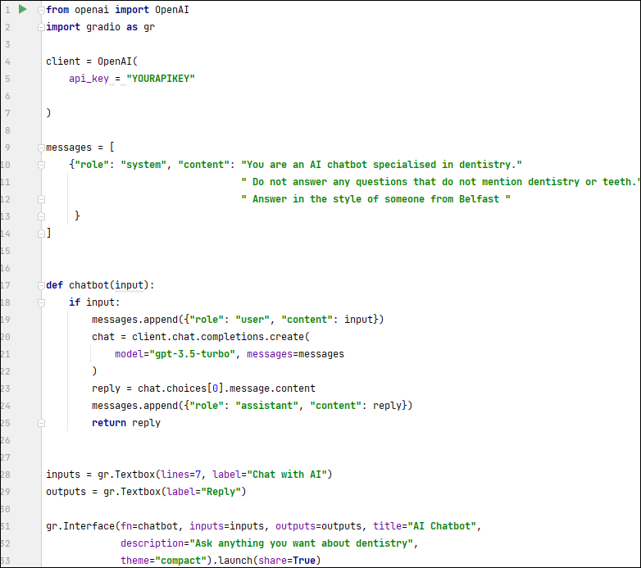
Code Listing
Two very hefty libraries are imported
openai – “a library provides convenient access to the OpenAI API from applications written in the Python language.”
gradio – “a library that is used to build machine learning and data science demos and web applications.” This easy to use UI also allows for a temporary public link for demo purposes
A message is sent via the API – this message has two properties: role and content
Here we giving a system level instruction to how the model should behave
30 lines of code to do something that would have seemed impossible 15 or 20 years ago

Slide 21
Text Encryption

Slide 22
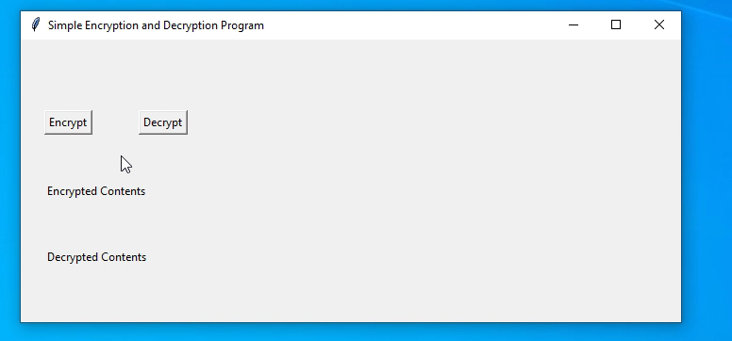
Encrypting file contents
With the aid of a GUI, encrypt the contents of a text file and decrypt it

Slide 23
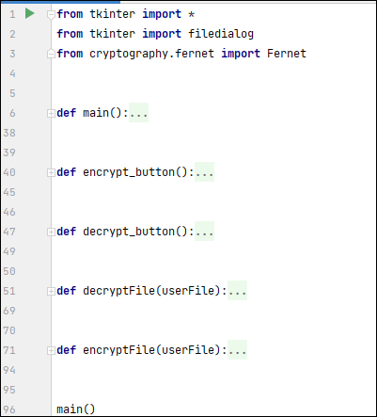
Decomposing the scenario
Create your GUI
Have code for selecting the file
Encrypt (using symmetric authenticated cryptography)
Decrypt

Slide 24
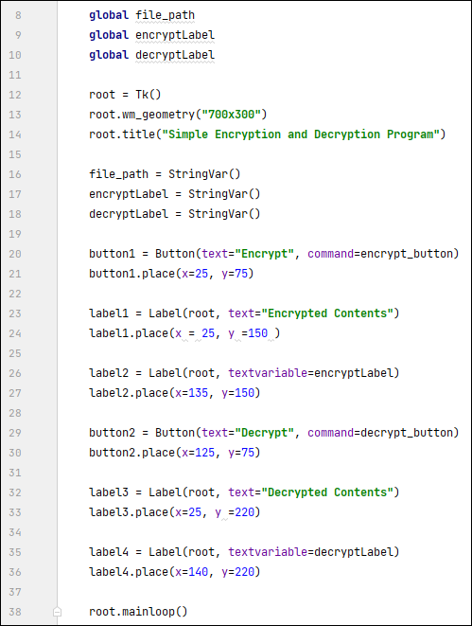
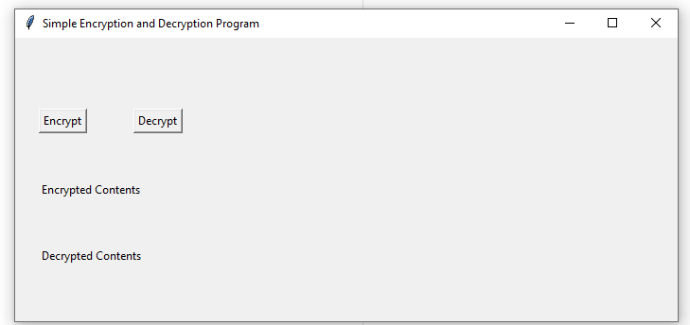
GUI – using Tkinter
Tkinter is a Python library that can be used to construct basic graphical user interface (GUI) applications.

Slide 25
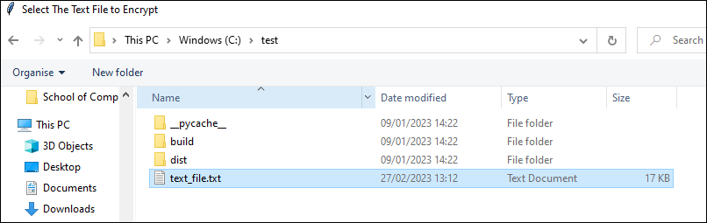
Code for selecting file
def encrypt_button(): filename = filedialog.askopenfilename(title="Select The Text File to Encrypt", filetypes=(("text files", ".txt"),)) file_path.set(filename) encryptFile(file_path.get())

Slide 26
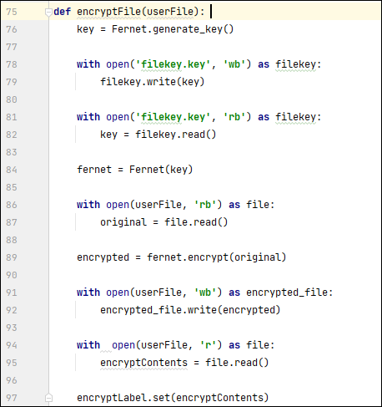
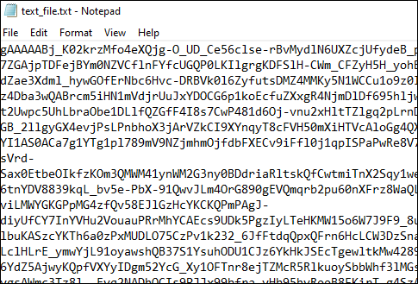
Encrypt the file (using Fernet)
Fernet is a symmetric encryption technique available to users in the cryptography module in Python that makes it easy to encrypt and decrypt text and provides an easy interface for beginners in cryptography.
A secret key is generated and stored in a file
The file selected by the user has its contents opened, and then encrypted and then written back to the file.

Slide 27
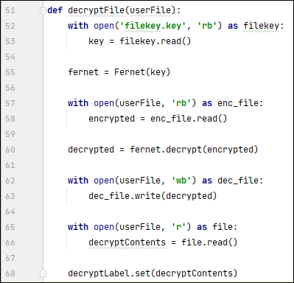
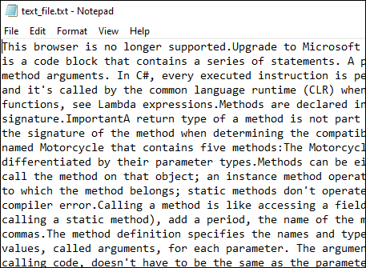
Decrypt the file
The file with the encrypted contents is opened, and the contents are decrypted and written back to the file

Slide 28
Voice Recognition and APIs

Slide 29
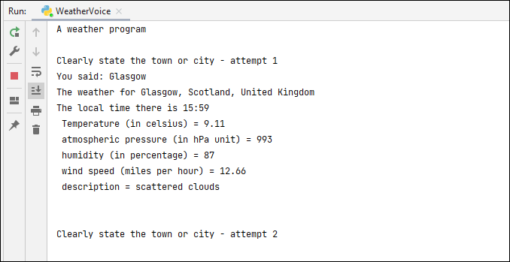
Voice Recognition and APIs
Here we’re going to say the name of a town or city and display the weather for it onscreen.

Slide 30
Breaking down the problem
We need Voice Recognition software
We need to get the word(s) said by the user
Pass that word into a real time system that monitors the weather
Filter and format the data returned and display it to the user

Slide 31
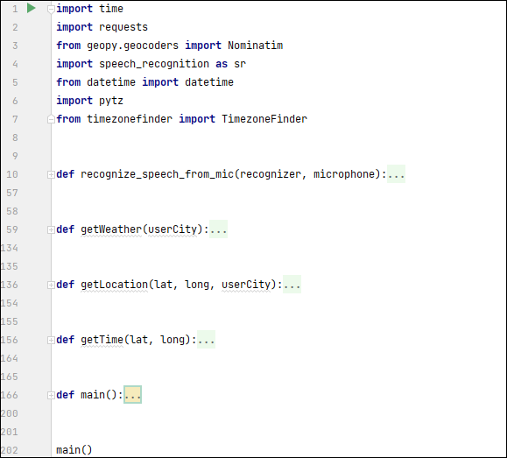
Program at a high level
The primary functions here are:
main()
recognize_speech_from_mic()
getWeather()
getLocation() & getTime() are secondary functions which make the program more usable for the end-user
getLocation() will return details of the town/city based on the latitude and longitude
getTime() will return the local time of the town based on latitude and longitude

Slide 32
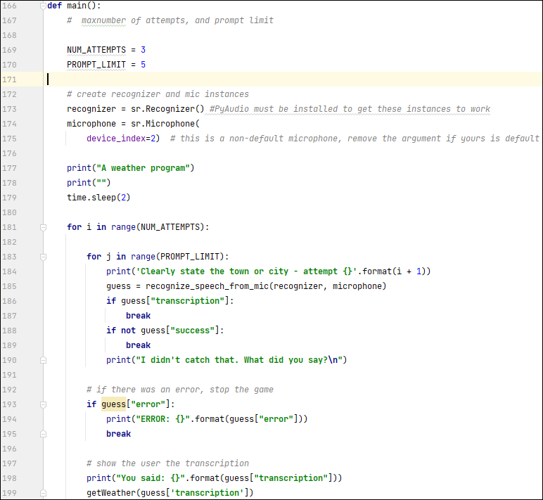
Main function
The key thing to take away here is that we have a loop which let the user get the weather for three cities. The program will ask 5 times for the name of each city.
We use a Python library called SpeechRecognition to listen out for the word(s) said by the user
A Microphone instance will get the word, the Recognizer instance will recognize it
These two instances will get passed in the function that will recognize the town or city

Slide 33
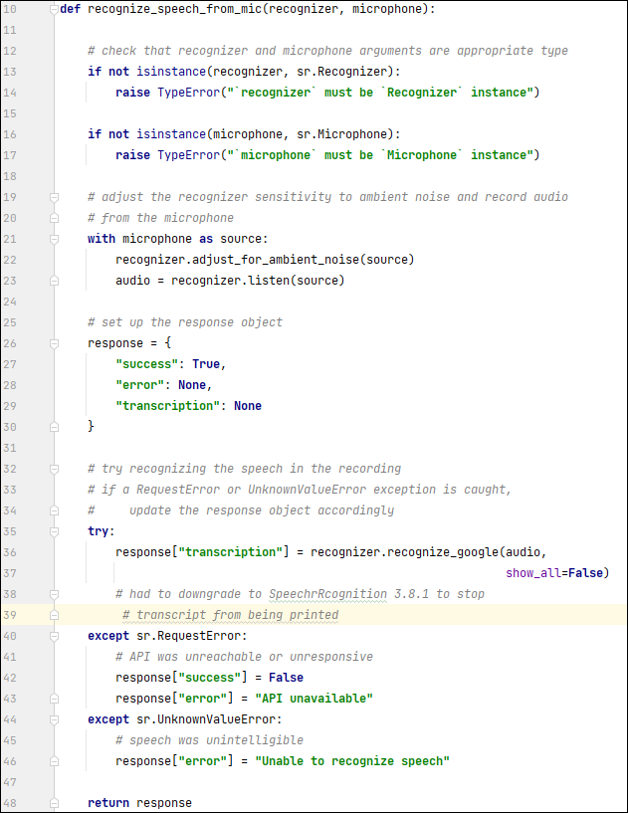

recognize_speech_from_mic function
Returns a dictionary with three keys:
"success": a boolean indicating whether or not the API request was successful
"error": `None` if no error occured, otherwise a string containing an error message if the API could not be reached or speech was unrecognizable
"transcription": `None` if speech could not be transcribed,
otherwise a string containing the transcribed text
A degree of confidence is assigned to what the user says
The transcribed text (i.e. the town or city said by the user) then return back to the main function which in turn is passed into the getWeather() function

Slide 34
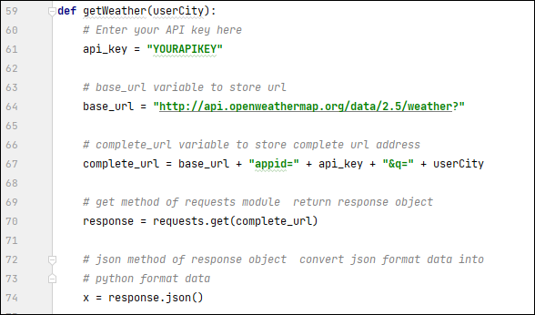
getWeather function (part 1)
Here we use an API (application programming interface) key to authenticate on the OpenWeatherMap website
Once authenticated we can get details of the town or city as a JSON file

Slide 35
JSON file
Here we asked for the weather details for Berlin, this is what gets returned from the OpenWeatherMap site as a JSON object
{'coord': {'lon': 13.4105, 'lat': 52.5244}, 'weather': [{'id': 500, 'main': 'Rain', 'description': 'light rain', 'icon': '10d'}], 'base': 'stations', 'main': {'temp': 277.53, 'feels_like': 272.81, 'temp_min': 276.53, 'temp_max': 278.7, 'pressure': 998, 'humidity': 67}, 'visibility': 10000, 'wind': {'speed': 7.15, 'deg': 194, 'gust': 11.18}, 'rain': {'1h': 0.13}, 'clouds': {'all': 75}, 'dt': 1678637978, 'sys': {'type': 2, 'id': 2011538, 'country': 'DE', 'sunrise': 1678598935, 'sunset': 1678640624}, 'timezone': 3600, 'id': 2950159, 'name': 'Berlin', 'cod': 200}
We can then filter that information accordingly

Slide 36
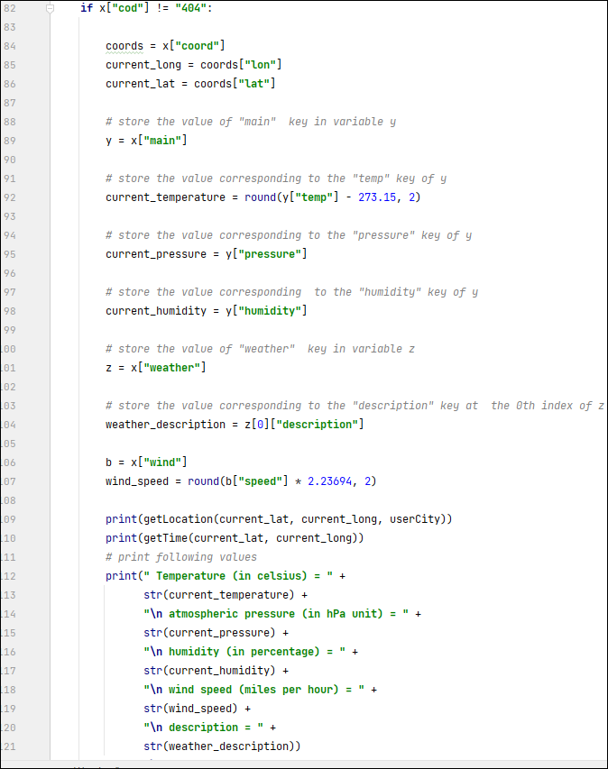
getWeather function (part ii)
And this is where we filter the JSON information
Temperature (returned in Kelvin, outputted in Celsius
Pressure
Humidity
Wind Speed
Weather Description
We get the latitude and longitude as well to get the precise details of the town/city and the time zone

Slide 37
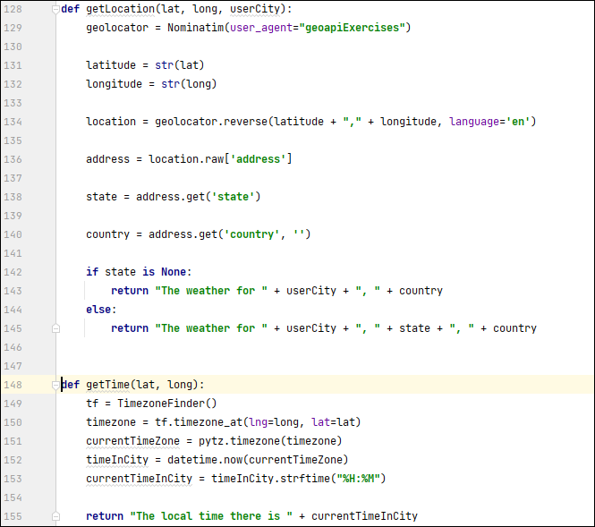
Secondary functions – time and location
getLocation() will return exact details based on latitude and longitude using a library – the details for Berlin are as follows
{'amenity': 'Platte', 'road': 'Memhardstraße', 'neighbourhood': 'Scheunenviertel', 'suburb': 'Mitte', 'borough': 'Mitte', 'city': 'Berlin', 'ISO3166-2-lvl4': 'DE-BE', 'postcode': '10178', 'country': 'Germany', 'country_code': 'de’}
getTime() works out the exact time based on the latitude and longitude co-ordinates

Slide 38
Thank You
Thank you for being on this module and good luck in your future modules.
Hopefully, this has given you a taste for problem solving using programming.

